Slide 1
Basic Database Administration
Lecture 2

Slide 2
Objectives
Define database administration.
Understand database administration tasks.
Perform database administration tasks using Oracle 11g Enterprise Manager.
Understand Oracle 11g and SQL Server data storage structures.

Slide 3
What is Database Administration?
A function in information technology (IT) department
Database Administrator (DBA)
Overall health / Performance
Manages Security
Setup Test and Dev. Environments

Slide 4
Duties of the DBA
Manage Database Objects – Tables / Views / Procedures
Database performance
Security – Logons /Users / Roles
Clone data from Production to Development or Test
Manage backups and carry out DR plans.

Slide 5

DBA Tools
?

Slide 6
DBA Tools Product Comparison
Oracle 11g
SQL Server
Oracle Enterprise Manager
Web-Based
SQL Server Management Studio
Client-Based

Slide 7
Oracle Enterprise Manager
User account must have DBA role
Oracle Enterprise Manager (OEM)
Three-tier architecture
Console
Oracle Management Server (OMS)
Interacts with repository
Makes it easier for DBAs to administer multiple databases in organization’s network

Slide 8
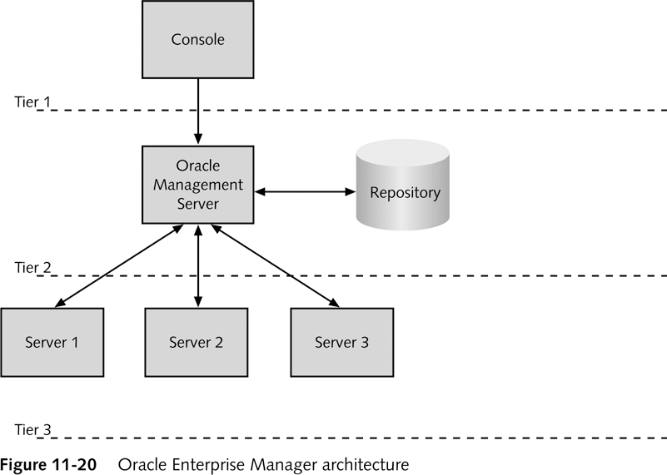
OEM Architecture

Slide 9
Demo
DBA Consoles

Slide 10
Managing Oracle 11g Data Storage
Like most DBMS’s the logical structures
Tables
Constraints
Views / Procedures
Can be stored in physical data structures
Files on disk
Dedicated drive partitions
RAM

Slide 11
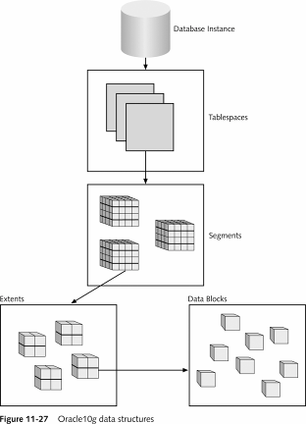
Oracle 11g Data Structures
Tablespace
One or more Data Files
Segment
Partitioned Data
Extent
Growth rule for segment
Data block
Database storage data block
Operating system blocks

Slide 12
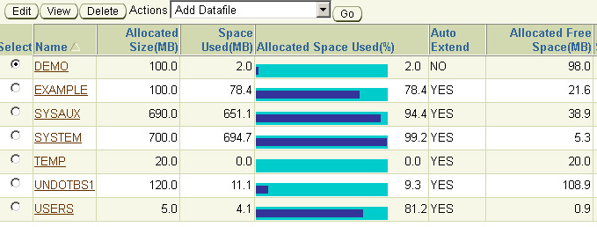
Tablespaces
One or more Data files
Stores all database structures + data
Tables, data, views, sp’s etc…

Slide 13
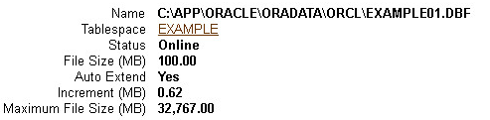
Datafiles
.dbf extensions
Store tablespace contents
Stored in Oracle_Base\oradata\SID
Use OEM to view and modify
Grow via Extents

Slide 14
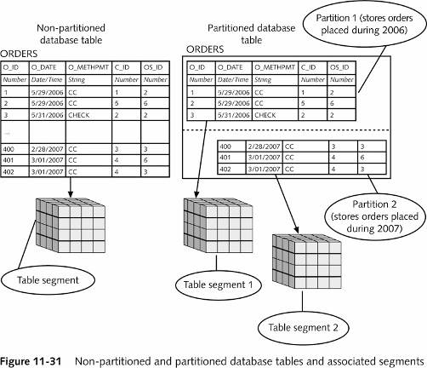
Segments – They Partition the data

Slide 15
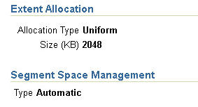
Extents – Smallest unit added to data file
Sequence of Data Blocks
When an insert grows beyond the data file size allocation, a new extent is added.
More efficient to add groups of data blocks vs. individual blocks.

Slide 16
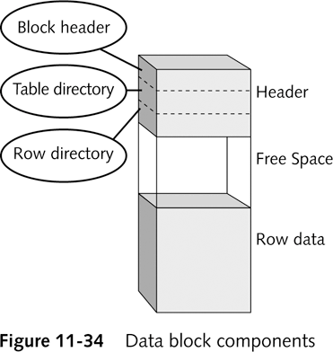
Data Blocks – Smallest Unit Read/Written

Slide 17
Managing Oracle 11g Data Structures
Create tablespace
Manage datafile extents
Autoextensible tablespace
Configure tablespace and datafile properties
Demo!

Slide 18
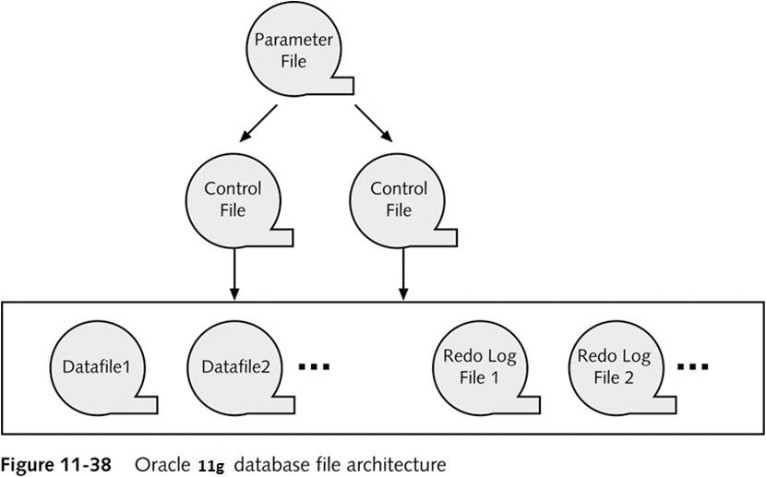
Oracle 11g Database File Architecture

Slide 19
Parameter File
Text file
Specifies configuration information about Oracle 11g database instance
init.ora
Stored in Oracle_Base\admin\SID\pfile folder
DBAs can edit parameter file
Modify database configuration

Slide 20
Control Files
Store information about database structure and state
Stored in Oracle_Base\oradata\SID
Three separate control files by default:
CONTROL01.CTL
CONTROL02.CTL
CONTROL03.CTL
All contain same data
At least one must be present

Slide 21
Redo Log Files
Records information to undo action query changes
.log extension
Stored in Oracle_Base\ORADATA\SID
Pre-image
Rollback segment

Slide 22
User Accounts
User

Slide 23
Creating and Managing User Accounts
Create new user account
General information about user account
System privileges user has in database
User’s tablespace quota on database server
Demo!

Slide 24
Specifying General User Information
Use OEM
General page:
Name
Profile
Authentication
Default tablespace
Temporary tablespace
Status

Slide 25
Specifying System Privileges
System privilege
Object privilege
Enable new user to interact with Oracle 11g database
DBA grants system privileges
Use System Privileges page in Create User page
Admin Option

Slide 26
Tablespace Quotas
Specifies amount of disk space that user’s database objects can occupy in default tablespace
Must be assigned
Quota Size value:
None, default
Unlimited
Value

Slide 27
Editing Existing User Accounts
Use OEM
Select user account to be modified on Users page
General page opens
Select other links to modify properties

Slide 28
Roles
Database object
Represents collection of system privileges
Assign to multiple users
Create role
Can inherit privileges from other roles
Grant Role to User Account
Easier than manually assigning everything manually.

Slide 29
Startup / Shutdown
?

Slide 30
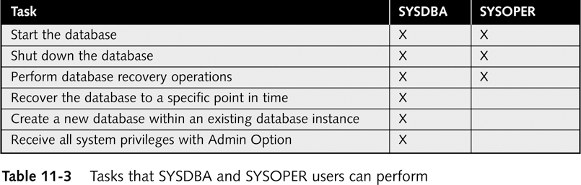
Starting /Shutting Down the Db
Shut down database periodically
Perform maintenance
Restart database

Slide 31
Creating an Administrative Connection
Shutting down database makes database unavailable for user connections
DBA must log onto database using administrative connection
SYS user account

Slide 32
Using OEM to Shut Down and Start a Database Instance
DBA shuts down database instance using Normal, Transactional, or Immediate shutdown option
Shutdown process performs five following tasks:
Writes contents of data buffer cache to datafiles
Writes contents of redo log buffer to redo log files
Closes all files
Stops all background processes
Deallocates SGA in server’s main memory

Slide 33
Instance Options
Startup
Shutdown
Start in one of two modes:
Unrestricted
Restricted
Specify one of four ways to handle existing user connections:
Normal
Transactional
Immediate
Abort

Slide 34
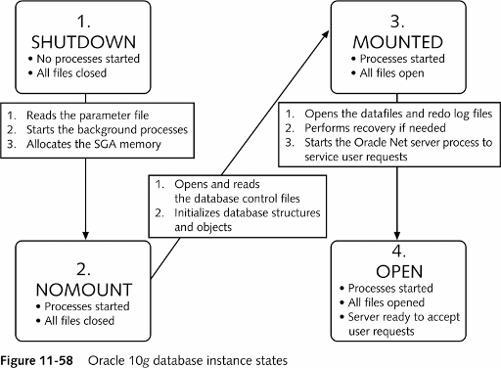
Oracle 11g Database Instance States

Slide 35

Questions?
?

